Slide 1
資安測試

Slide 2
數位鑑識

Slide 3
數位鑑識

Slide 4
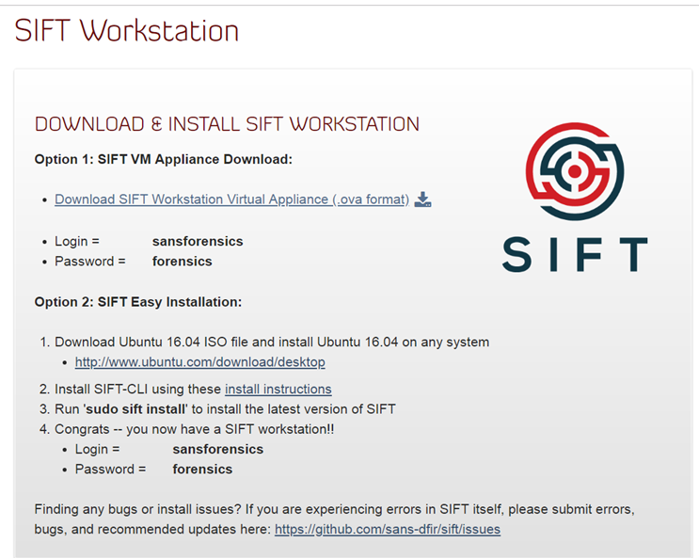
下載https://digital-forensics.sans.org/community/downloads

Slide 5
案例分析
Forensics Quickie: NTUSER.DAT Analysis (SANS CEIC 2015 Challenge #1 Write-Up)
https://web.archive.org/web/20180212144009/http://www.4n6k.com:80/2015/05/forensics-quickie-ntuserdat-analysis.html
SANS SIFT - NTUSER.DAT Forensics Challenge Walkthrough
https://www.youtube.com/watch?v=OBp6SHgSSZg

Slide 6
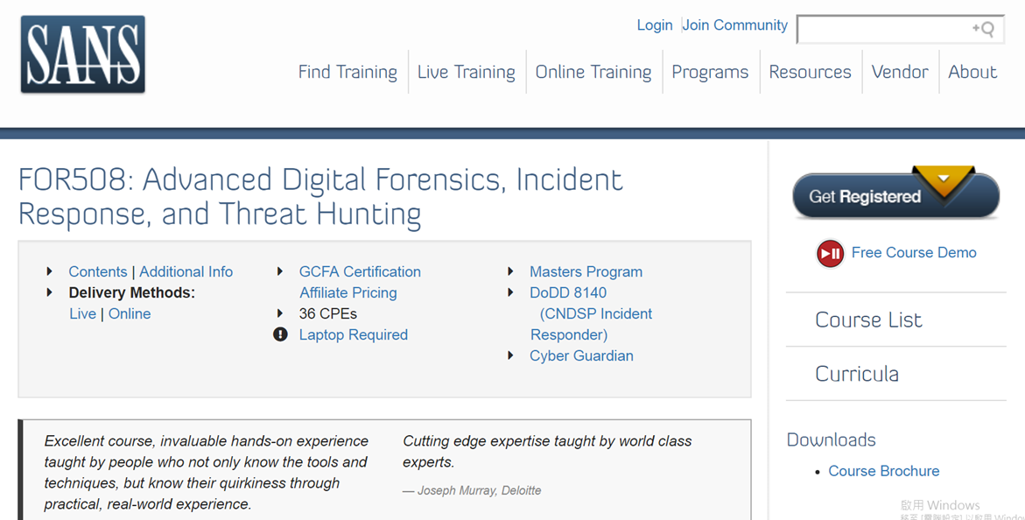
訓練課程架構 https://www.sans.org/course/advanced-incident-response-threat-hunting-training#__utma=71453702.1249588636.1547033495.1547033495.1547033495.1

Slide 7
SIFT Workstation@YOUTUBE
Getting Started with the SIFT Workstation Webcast with Rob Lee
https://www.youtube.com/watch?v=ai_7Fkv6igw
SANS SIFT - Copying E01 Forensic Image Files to SIFT Workstation https://www.youtube.com/watch?v=plZGyW_W_oY
Mount APFS Disk on SANS SIFt (Linux) with ewfmount
https://www.youtube.com/watch?v=ZhriR0PWNi8

Slide 8
漏洞掃描
https://www.concise-courses.com/hacking-tools/web-vulnerability-scanners/
有9個工具

Slide 9



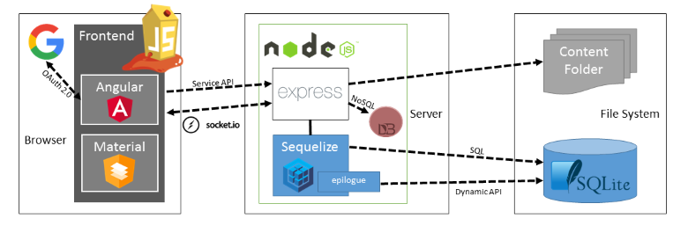
OWASP Juice Shop
https://www.owasp.org/index.php/OWASP_Juice_Shop_Project
Hands-On Web Security: Capture the Flag with OWASP Juice Shop
By Simon Bennetts
Posted on March 8, 2018
https://hacks.mozilla.org/2018/03/hands-on-web-security-capture-the-flag-with-owasp-juice-shop/
BeNeLux Day 2018: Juice Shop: OWASP's Most Broken Flagship - Björn Kimminich
https://www.youtube.com/watch?v=Lu0-kDdtVf4

Slide 10


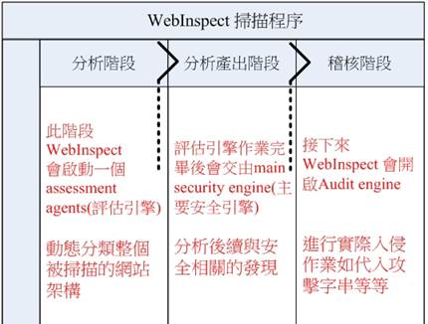
http://www.pacific-3c.com/hp_webinspect.html

Slide 11

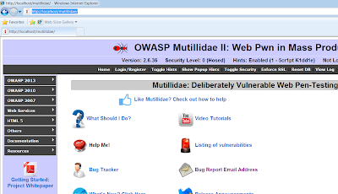

OWASP Mutillidae II
https://github.com/webpwnized/mutillidae

Slide 12



https://www.qa-knowhow.com/?p=1651
Java版
https://gbhackers.com/scanning-owasp-top-10/
Ubuntu 16.04下安裝還是比較方便的
使用命令：apt-get install docker.io
安裝成功之後，查看是否安裝成功：docker --version
然後使用如下命令，下載容器： docker pull webgoat/webgoat-8.0
下載完成之後如上圖所示，接下來查看一下，使用命令： docker images
接下來運行它，使用命令：docker run -p 8080:8080 -t webgoat/webgoat-8.0
Nikto web server scanner - https://cirt.net/Nikto2
Full documentation - https://cirt.net/nikto2-docs/
https://github.com/sullo/nikto
https://zhuanlan.zhihu.com/p/31777509

Slide 13




LINUX及LINUX伺服器安全
Rapid7 Metasploitable-2
https://www.rapid7.com/products/nexpose/
https://metasploit.help.rapid7.com/docs/metasploitable-2
https://metasploit.help.rapid7.com/docs/metasploitable-2-exploitability-guide

Slide 14



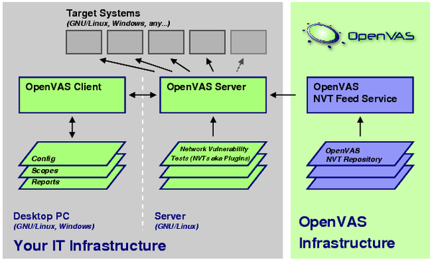
Windows及Windows伺服器安全
Metasploitable3
https://github.com/rapid7/metasploitable3

Slide 15

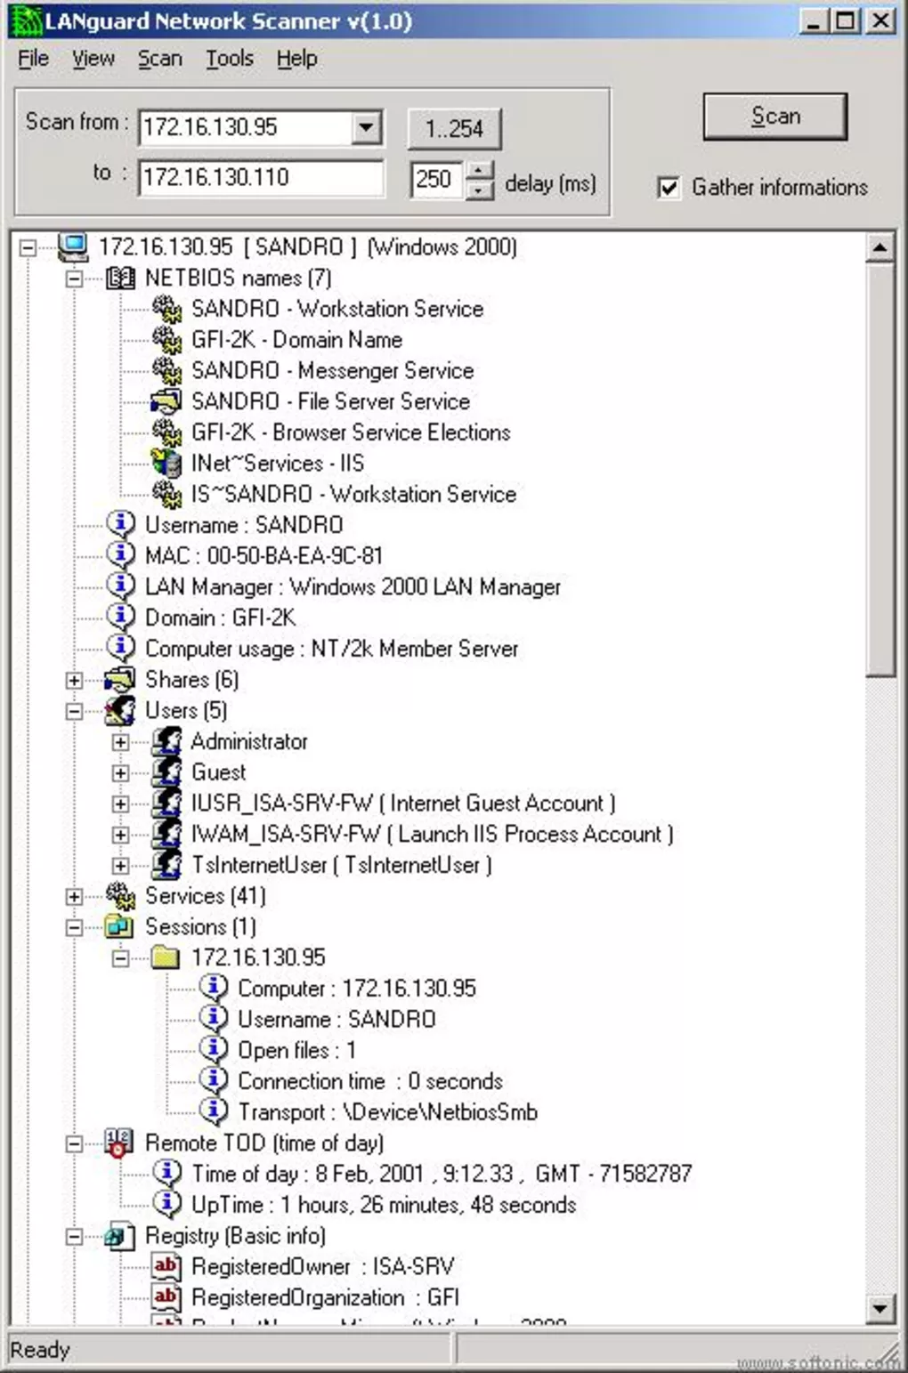
https://fuxi-scanner.com
Fuxi-Scanner
https://github.com/jeffzh3ng/Fuxi-Scanner
Metasploitable3
https://github.com/rapid7/metasploitable3

Slide 16
網路攻防測試
Firewall實戰

Slide 17

Netfilter
原理
防火牆
頻寬管理
連線管制
Linux
防火牆
Ufw/Iptables
防火牆攻防實務１:
禁止敵國的IP存取
防火牆
firewall
防火牆攻防實務2:
禁止IP scan
Linux
nftables
防火牆攻防實務3:
禁止DDoS
https://player.slideplayer.com/16/5119288/#

Slide 18
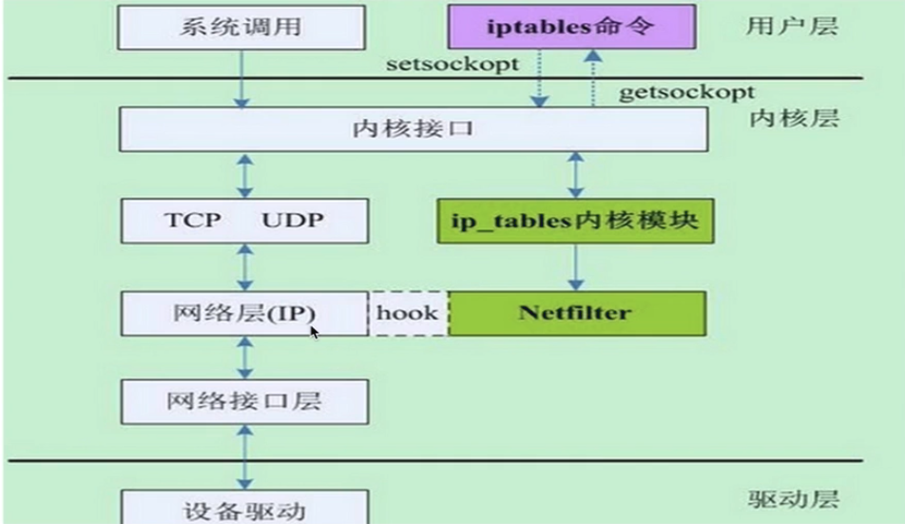



https://wangchujiang.com/linux-command/c/firewall-cmd.html
firewall-cmd
Ufw/Iptables
Firewalld
/Centos 7
https://help.ubuntu.com/community/IptablesHowTo

Slide 19
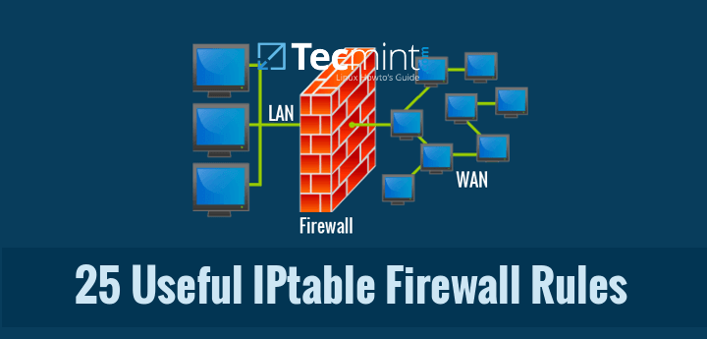
https://www.tecmint.com/linux-iptables-firewall-rules-examples-commands/

Slide 20
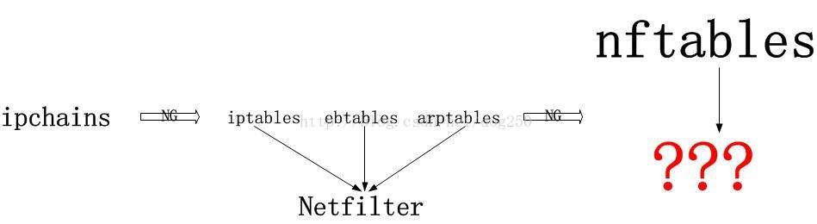
nftables 是新式的數據包過濾框架，從 Linux 內核 3.13 版本開始可用，旨在替代現用的 iptables 框架。
https://farkasity.gitbooks.io/nftables-howto-zh/content/index.html
https://wiki.nftables.org/wiki-nftables/index.php/Main_Page
https://blog.csdn.net/dog250/article/details/54170683

Slide 21
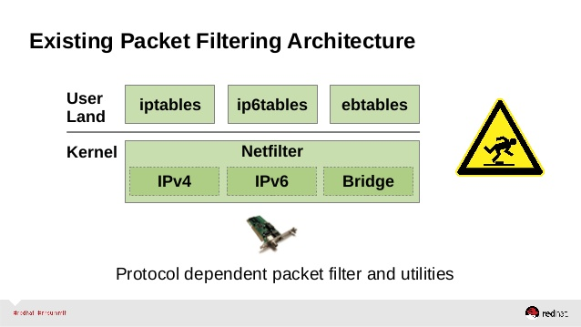

Slide 22
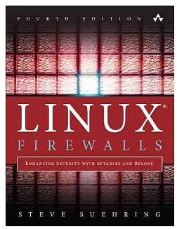
Linux防火牆規則的查看.添加.刪除和修改
http://www.geren-jianli.net/zl/844022082.html
http://www.geren-jianli.net/zl/629946656.html
http://www.geren-jianli.net/zl/886528912.html
http://www.geren-jianli.net/zl/805980154.html

Slide 23
Nftables/nfd指令 https://en.wikipedia.org/wiki/Nftables
drop any packets with the destination IP address 1.2.3.4
nft add rule ip filter output ip daddr 1.2.3.4 drop
iptables -A OUTPUT -d 1.2.3.4 -j DROP

Slide 24
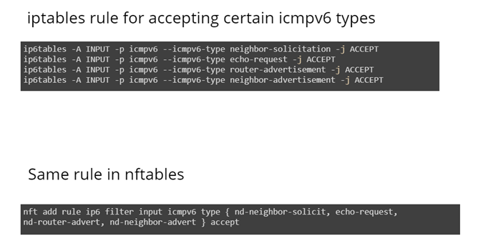
https://slides.com/shivanibhardwaj/netfilter-hooksan-easy-guide#/8

Slide 25


防火牆攻防實務１:
禁止Ping scan攻擊
Ping scan攻擊
Ping Scan using NMAP
https://dotblogs.com.tw/ghoseliang/2012/10/05/75289

Slide 26
防火牆攻防實務2:
禁止sync flood攻擊
sync flood

Slide 27
防止 sync flood 攻擊的設定:
iptables -N synfoold
iptables -A synfoold -p tcp --syn -m limit --limit 1/s -j RETURN
iptables -A synfoold -p tcp -j REJECT --reject-with tcp-reset
iptables -A INPUT -p tcp -m state --state NEW -j synfoold
這個方式對於一個很忙碌的站台來說，這個設定方式會不會有不良影響呢？
測試過一個很忙碌的站台用這個設定，老實說並不好....
所以也許可以調整時間與次數的觸發值。

Slide 28
http://www.study-area.org/tips/iptables_def.htm
防止 Ping of Death :
iptables -N ping
iptables -A ping -p icmp --icmp-type echo-request -m limit --limit \
1/second -j RETURN
iptables -A ping -p icmp -j REJECT
iptables -I INPUT -p icmp --icmp-type echo-request -m state --state NEW \
-j ping
這裡只有把 icmp 的 echo request 部份拒絕掉，可以視情況再調整。
或者是直接設定主機不回應 echo request 。
/proc/sys/net/ipv4/icmp_echo_ignore_all

Slide 29
網路攻防測試
Snort實戰

Slide 30


Bro (Zeek)
Network Monitoring
https://github.com/zeek/zeek
https://en.wikipedia.org/wiki/Zeek
https://en.wikipedia.org/wiki/Suricata_(software)
IDS
Snort IDS
IDS攻防實務１:
Syn Flood 偵測
http://www.ccs-labs.org/~dressler/teaching/netzwerksicherheit-ws0607/16_AttackDetection-v2.pdf
https://en.wikipedia.org/wiki/Prelude_SIEM_(Intrusion_Detection_System)
Prelude Hybrid IDS
https://www.netadmin.com.tw/article_print.aspx?sn=1802020008
http://maskray.me/blog/2013-07-26-ids-ips-with-suricata
https://github.com/bro/bro

Slide 31

How to detect a DDoS attack? DDOS攻擊的偵測技術
https://www.itread01.com/content/1508133497.html
hping3 -S -p 80 --flood --rand-source 被打的電腦IP
DDOS攻擊
https://serverfault.com/questions/178437/snort-rules-for-syn-flood-ddos
alert tcp !$HOME_NET any -> $HOME_NET 80 (flags: S; msg:"Possible TCP DoS"; flow: stateless; threshold: type both, track by_src, count 70, seconds 10; sid:10001;rev:1;)

Slide 32
Web網站攻防測試

Slide 33
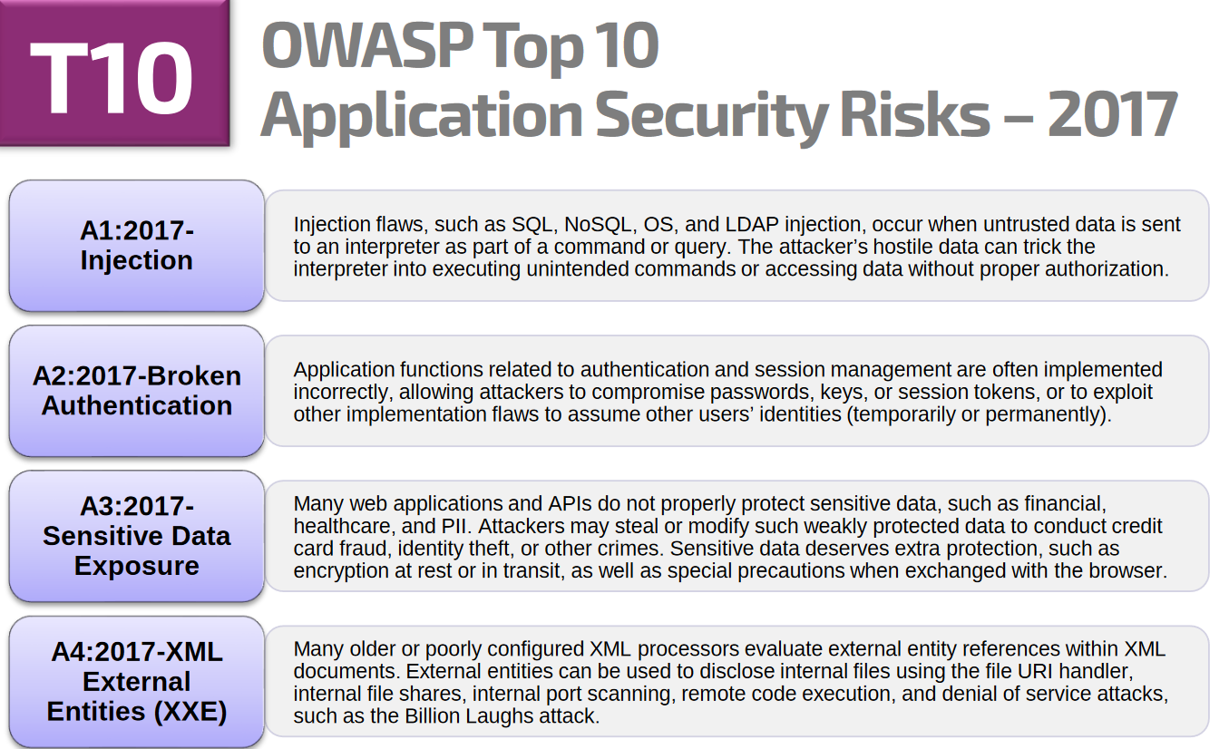


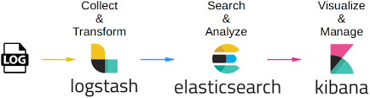
ModSecurity Masterclass
https://www.feistyduck.com/training/modsecurity-training-course
兩天課程:CHF1,550 瑞士法郎
WAFs are basically deployed inline in three different ways. According to NSS Labs, deployment options are transparent bridge, transparent reverse proxy, and reverse proxy
Visualizing Apache and ModSecurity Log Files
https://www.netnea.com/cms/apache-tutorial-11_visualizing-log-files/
Defending Against Web App Attacks Using ModSecurity
https://www.youtube.com/watch?v=bqNZlN-imF8
https://github.com/molu8bits/modsecurity-parser
WAF
Web攻防實務１:
SQLi攻擊的防禦
Web分析實務１:
SQLi攻擊的防禦分析
https://en.wikipedia.org/wiki/Web_application_firewall
Web攻防實務2:
XSS攻擊的防禦
What is a Web Application Firewall (WAF)?
https://www.youtube.com/watch?v=p8CQcF_9280
https://resources.infosecinstitute.com/analyzing-mod-security-logs/#gref

Slide 34
the best hardware-based web application firewalls:
Imperva SecureSphere
Barracuda Web Application Firewall
Citrix Netscaler Application Firewall
Fortinet FortiWeb
F5 BIG-IP ASM
https://www.comparitech.com/net-admin/best-web-application-firewall/

Slide 35
Cloud-based WAFs
https://www.comparitech.com/net-admin/best-web-application-firewall/
StackPath Web Application Firewall (FREE TRIAL)
Sucuri Website Firewall (LEARN MORE)
Cloudflare WAF
Akamai Kona Site Defender
F5 Silverline Web Application Firewall
Amazon Web Services WAF
Incapsula Web Application Firewall

Slide 36
Web測試環境:web2019.ova Web測試環境建置手冊
Ubuntu 18.04 LTS
Nginx
PHP
Mysql
Modsecurity
Node.js
docker
漏洞平台
OWASPBWA
WebGoat
DVWA

Slide 37

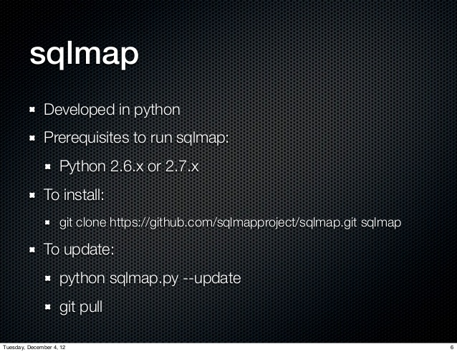
Sql injection
Sql injection with sqlmap
https://www.slideshare.net/hcoduarte/sql-injection-with-sqlmap

Slide 38



Sql injection
Sql injection with sqlmap
https://www.slideshare.net/hcoduarte/sql-injection-with-sqlmap
OWASP ModSecurity Core Rule Set (CRS)
https://modsecurity.org/crs/

Slide 39
modsecurity 可以阻擋 command injection 和 file inclusion攻擊嗎??
if modsecurity can protect against command injection and file inclusion
command injection
file inclusion
Cross-Site Scripting (XSS)
Cross-Site Request Forgery(CSRF)
Path Traversal attack
OWASP Mutillidae II
Session Fixation
[讚]https://www.htbridge.com/blog/patching-complex-web-vulnerabilities-using-modsecurity-waf.html
https://security.stackexchange.com/questions/165037/protection-against-command-injection-with-modsecurity

Slide 40
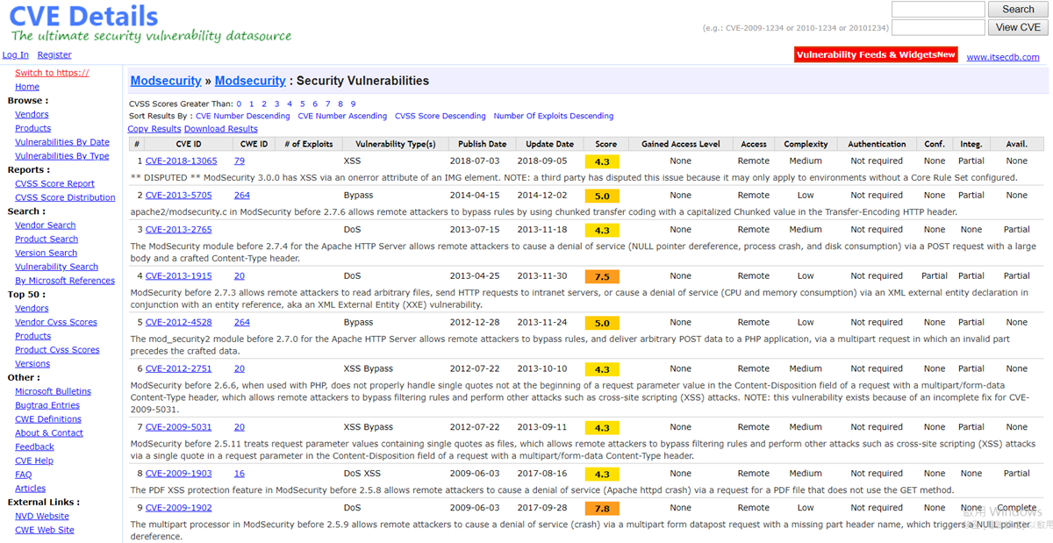
https://www.cvedetails.com/vulnerability-list/vendor_id-9781/product_id-17488/Modsecurity-Modsecurity.html

Slide 41
Web滲透測試

Slide 42


Assessing and Exploiting Web Applications with Samurai-WTF
Published on Mar 29, 2012
https://issuu.com/elhacklab/docs/samurai-wtf_course_slides
installation and configuration of bWAPP on the Samurai Web Testing Framework.
https://www.bestcybernews.com/2013/09/bwapp-samurai-wtf.html
https://sourceforge.net/projects/samurai/files/
https://github.com/SamuraiWTF/samuraiwtf
http://www.samurai-wtf.org/

Slide 43
網站安全測試
https://google-gruyere.appspot.com/code/
白箱測試➔檢查原始碼的漏洞
Web Application Exploits and Defenses
http://google-gruyere.appspot.com/
黑箱測試
To access Gruyere, go to https://google-gruyere.appspot.com/start. AppEngine will start a new instance of Gruyere for you, assign it a unique id and redirect you to https://google-gruyere.appspot.com/123/ (where 123 is your unique id). Each instance of Gruyere is "sandboxed" from the other instances so your instance won't be affected by anyone else using Gruyere. You'll need to use your unique id instead of 123 in all the examples. If you want to share your instance of Gruyere with someone else (e.g., to show them a successful attack), just share the full URL with them including your unique id.
Want to beat the hackers at their own game?
Learn how hackers find security vulnerabilities!
Learn how hackers exploit web applications!
Learn how to stop them!
This codelab shows how web application vulnerabilities can be exploited and how to defend against these attacks. The best way to learn things is by doing, so you'll get a chance to do some real penetration testing, actually exploiting a real application.
Specifically, you'll learn the following:
How an application can be attacked using common web security vulnerabilities, like cross-site scripting vulnerabilities (XSS) and cross-site request forgery (XSRF).
How to find, fix, and avoid these common vulnerabilities and other bugs that have a security impact, such as denial-of-service, information disclosure, or remote code execution.
To get the most out of this lab, you should have some familiarity with how a web application works (e.g., general knowledge of HTML, templates, cookies, AJAX, etc.).

Slide 44
Raven Vulnhub Walkthrough CTF - Beginner Challenge
https://www.youtube.com/watch?v=rebTtXiiOgA
https://www.vulnhub.com/entry/raven-1,256/#
線上滲透測試平臺：https://www.hackthebox.eu/en
Kioptrix: Level 1 (#1) https://www.vulnhub.com/entry/kioptrix-level-1-1,22/ Kioptrix: Level 1.1 (#2) https://www.vulnhub.com/entry/kioptrix-level-11-2,23/ Kioptrix: Level 1.2 (#3) https://www.vulnhub.com/entry/kioptrix-level-12-3,24/ Kioptrix: Level 1.3 (#4) https://www.vulnhub.com/entry/kioptrix-level-13-4,25/ Kioptrix: 2014 https://www.vulnhub.com/entry/kioptrix-2014-5,62/ FristiLeaks: 1.3 https://www.vulnhub.com/entry/fristileaks-13,133/ Stapler: 1 https://www.vulnhub.com/entry/stapler-1,150/ VulnOS: 2 https://www.vulnhub.com/entry/vulnos-2,147/ SickOs: 1.2 https://www.vulnhub.com/entry/sickos-12,144/ Brainpan: 1https://www.vulnhub.com/entry/brainpan-1,51/ HackLAB: Vulnix https://www.vulnhub.com/entry/hacklab-vulnix,48/ /dev/random: scream https://www.vulnhub.com/entry/devrandom-scream,47/ pWnOS: 2.0 https://www.vulnhub.com/entry/pwnos-20-pre-release,34/ SkyTower: 1 https://www.vulnhub.com/entry/skytower-1,96/ Mr-Robot: 1 https://www.vulnhub.com/entry/mr-robot-1,151/ PwnLab: init https://www.vulnhub.com/entry/pwnlab-init,158/

Slide 45
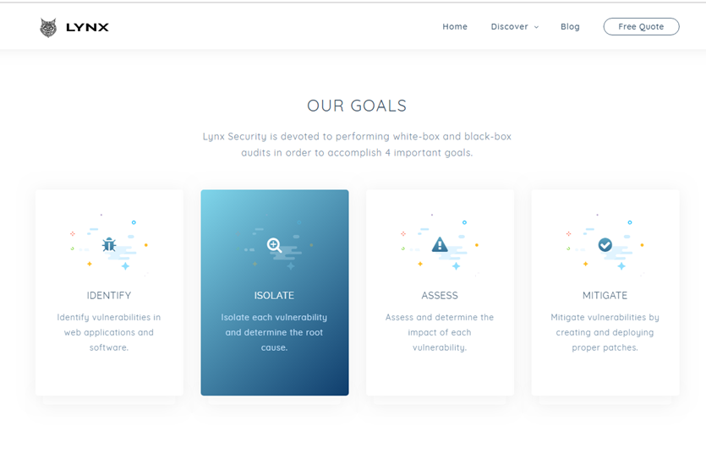
https://www.lynxsecurity.io/

